Slide 1
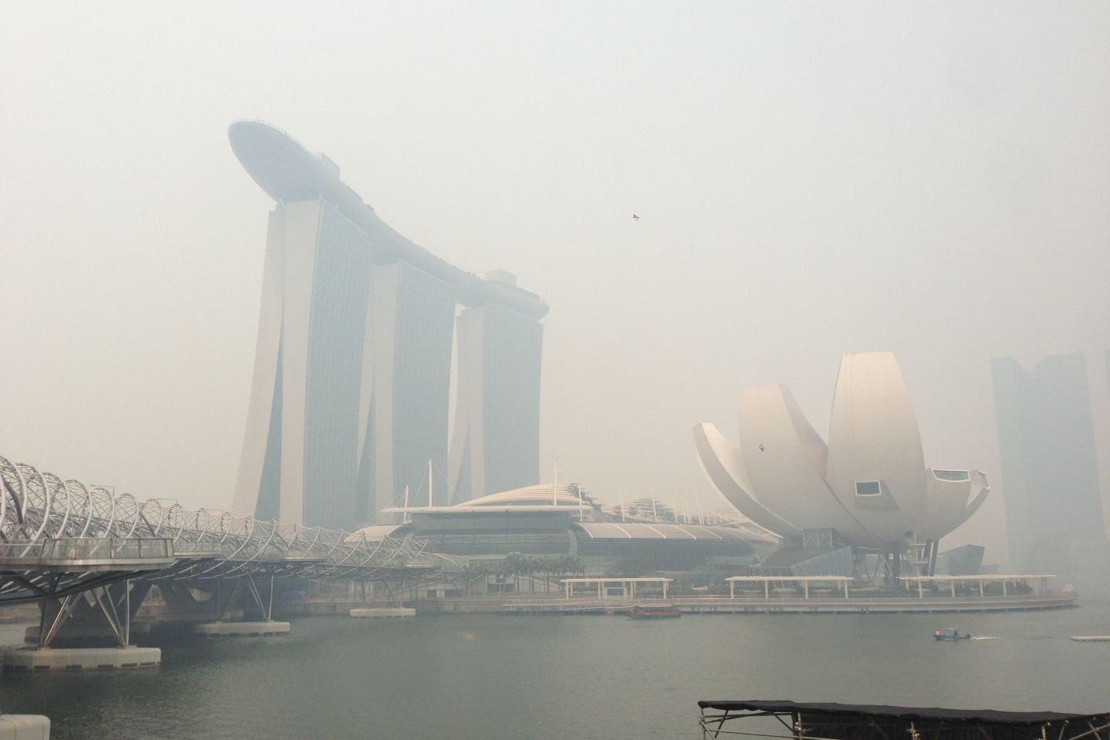

Milestone Project – Pollutant Standard Index and GENTING Share Prices IN SINGAPORE
WQD7005 - Data Mining
Guided by Professor Dr. The Ying Wah
Presented by Lim Li Them (WQD170093)
WQD7005 - Data Mining
Milestone Project | Pollutant Standard Index and Tourism Share Prices in Singapore
Master of Data Science | University of Malaya

Slide 2
Table of Contents
Introduction and research background
Research objectives
Research methodology
Data collection and description
Results
Conclusions
WQD7005 - Data Mining
Milestone Project | Pollutant Standard Index and Tourism Share Prices in Singapore
Master of Data Science | University of Malaya

Slide 3
Introduction and research background
The Pollutant Standards Index, or PSI, is a type of air quality index, which is used to indicate the level of pollutants in air.
The PSI is reported on a scale of 0 to 500, to reflect whether the air pollution levels in a particular location are good, unhealthy, hazardous or worse.
PSI | Descriptor | General Health Effects
0–50 | Good | None
51–100 | Moderate | Few or none for the general population
101–200 | Unhealthy | Everyone may begin to experience health effects; members of sensitive groups may experience more serious health effects. To stay indoors.
201-300 | Very unhealthy | Health warnings of emergency conditions. The entire population is more likely to be affected.
301+ | Hazardous | Health alert: everyone may experience more serious health effects
Source: https://en.wikipedia.org/wiki/Pollutant_Standards_Index
WQD7005 - Data Mining
Milestone Project | Pollutant Standard Index and Tourism Share Prices in Singapore
Master of Data Science | University of Malaya

Slide 4
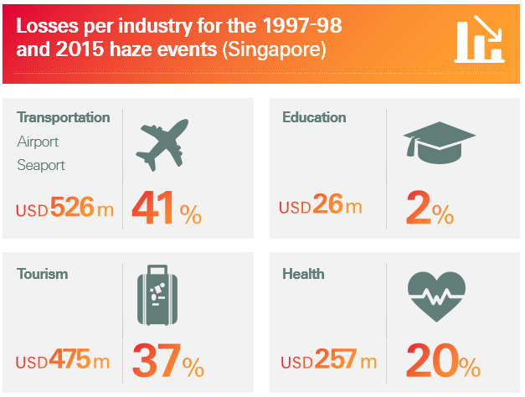
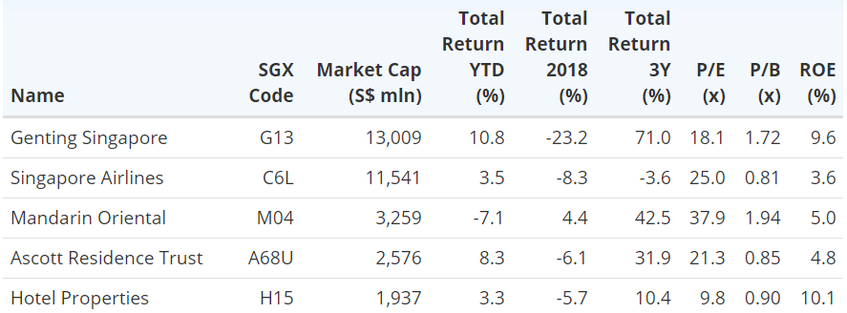
Introduction and research background
Economics impact caused by haze outbreak: Top 5 tourism stocks in Singapore sorted by market capitalization:
Source: Bloomberg & SGX StockFacts (data as of 29 January 2019)
Source: https://corporatesolutions.swissre.com/innovative-risk-solutions/non-physical-damage-business-interruption/hazeshield.html
WQD7005 - Data Mining
Milestone Project | Pollutant Standard Index and Tourism Share Prices in Singapore
Master of Data Science | University of Malaya

Slide 5
Research objectives
The objectives of this research are:
To determine the relationship between Pollutant Standard Index (PSI) reading and the G13 stock price
To identify the other factors that affect G13 stock price
To understand the public sentiment toward haze through Twitter
WQD7005 - Data Mining
Milestone Project | Pollutant Standard Index and Tourism Share Prices in Singapore
Master of Data Science | University of Malaya

Slide 6


Research methodology
Tools applied:
Ananconda Jupyter Notebook 5.7.4
SAS Enterprise Miner 9.4
Algorithms deployed:
Decision Tree
Logit Regression
Linear Regression (Ordinary Least Square)
WQD7005 - Data Mining
Milestone Project | Pollutant Standard Index and Tourism Share Prices in Singapore
Master of Data Science | University of Malaya

Slide 7




Data collection and description
There are 5 types of data files:
Pollutant Standard Index (PSI)
Real time and historical data from year 2009 until
year 2019
Source: Data.gov.sg
Tourism Stock Prices
Secondary data from year 2009 until year 2019
Source: Yahoo Finance
International Tourist Arrival Data
Secondary data from year 1978 until year 2019
Source: Department of Statistics Singapore
YOY Gross Domestic Product (GDP) Growth Rate
Secondary data from year 2009 until year 2019
Source: Data.gov.sg
Tweets
Real time data from 20th September until 9th October 2019
Source: Twitter
WQD7005 - Data Mining
Milestone Project | Pollutant Standard Index and Tourism Share Prices in Singapore
Master of Data Science | University of Malaya

Slide 8
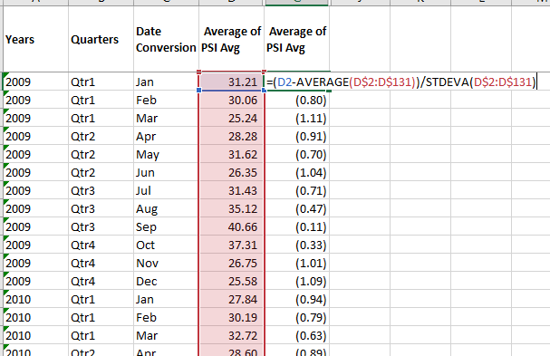
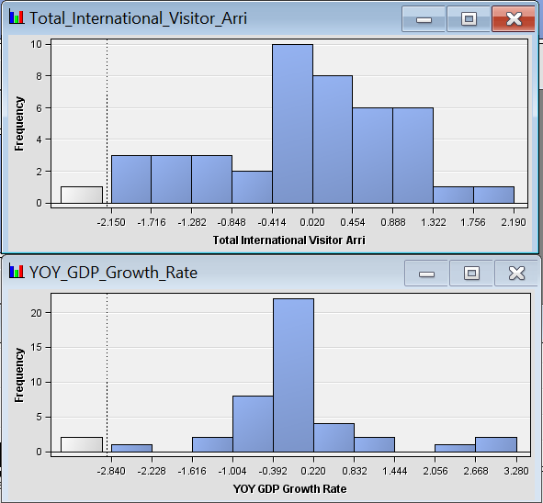
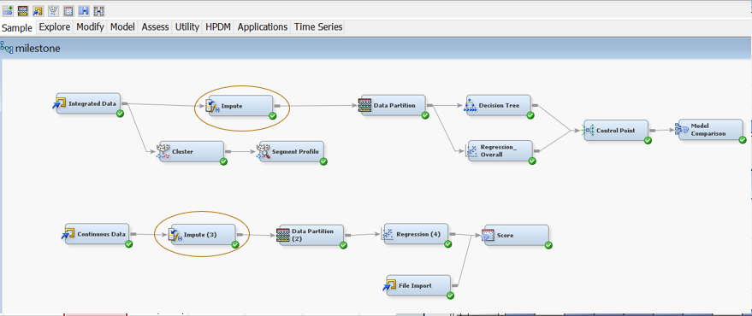
DATE PRE-PROCESSING
WQD7005 - Data Mining
Milestone Project | Pollutant Standard Index and Tourism Share Prices in Singapore
Master of Data Science | University of Malaya

Slide 9
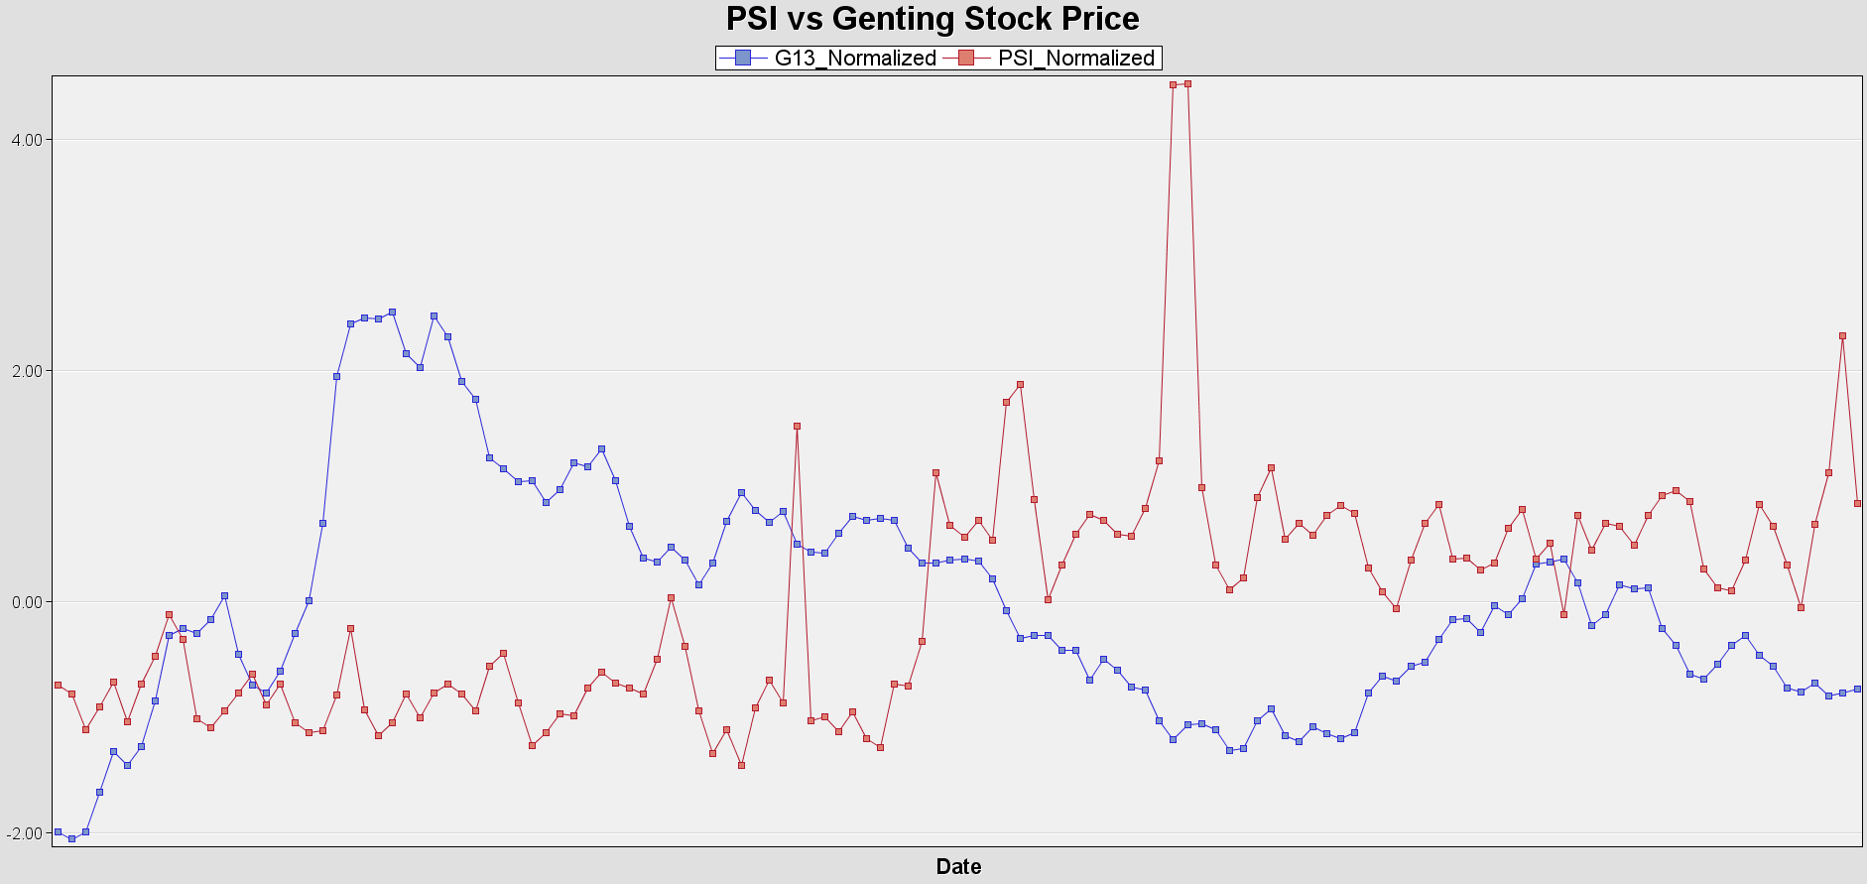
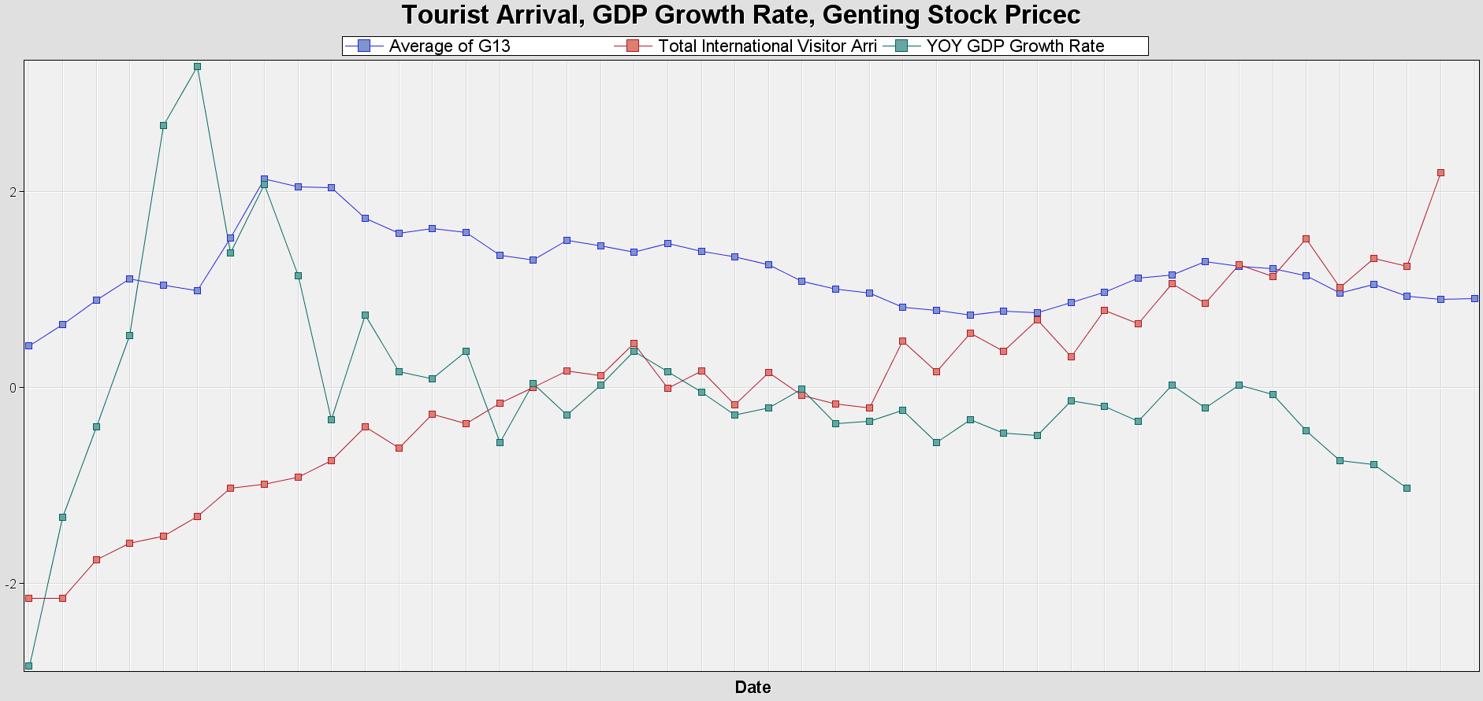
Data collection and description
WQD7005 - Data Mining
Milestone Project | Pollutant Standard Index and Tourism Share Prices in Singapore
Master of Data Science | University of Malaya

Slide 10
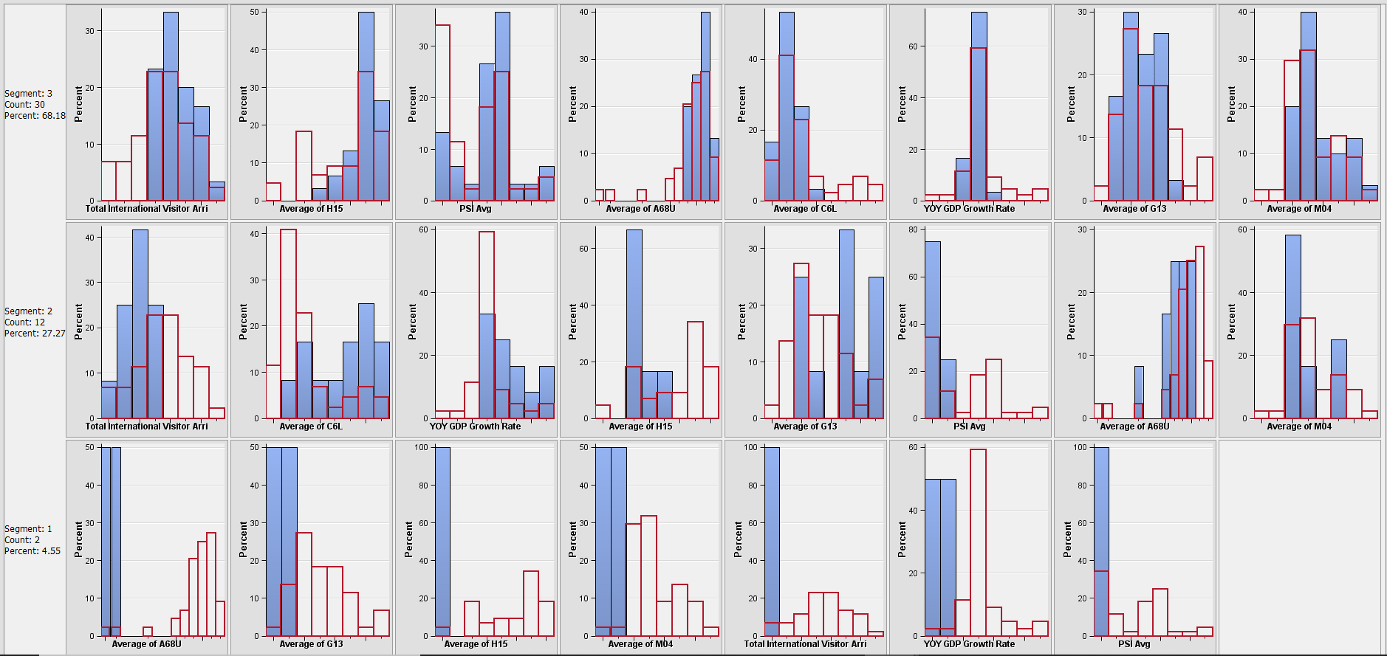
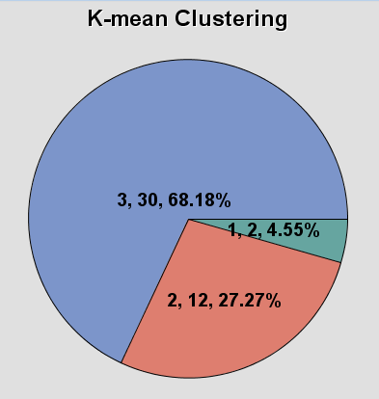
Data collection and description
WQD7005 - Data Mining
Milestone Project | Pollutant Standard Index and Tourism Share Prices in Singapore
Master of Data Science | University of Malaya

Slide 11
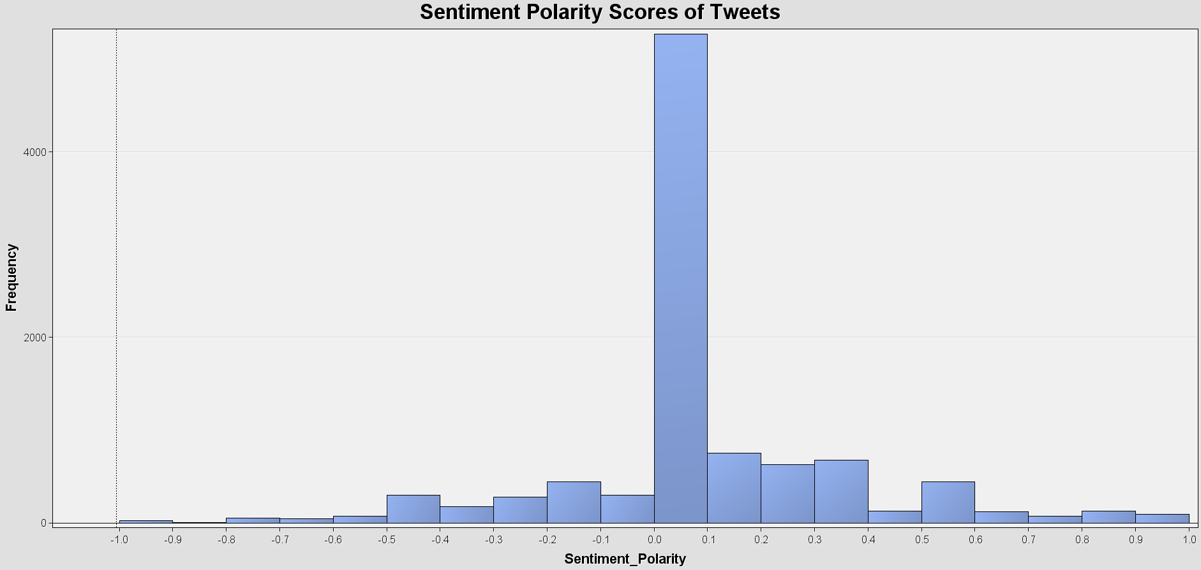
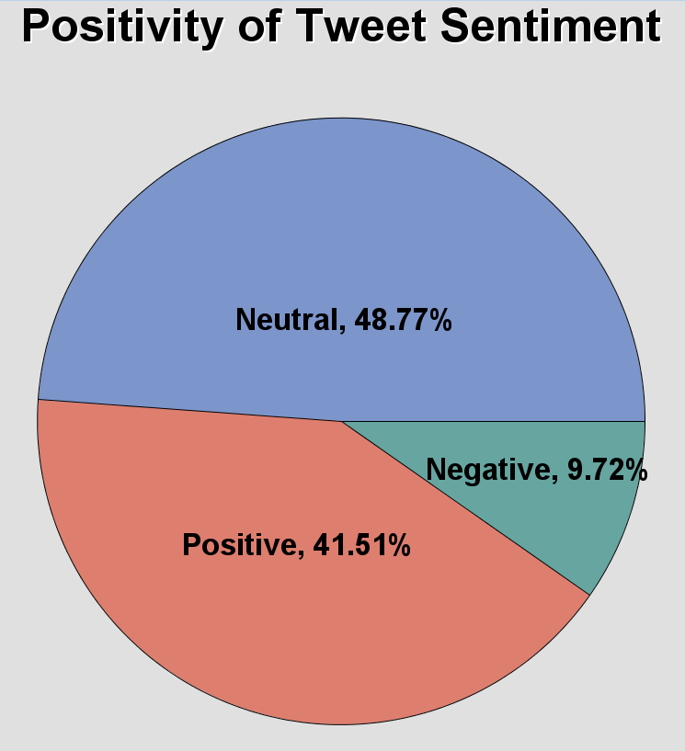
Data collection and description
WQD7005 - Data Mining
Milestone Project | Pollutant Standard Index and Tourism Share Prices in Singapore
Master of Data Science | University of Malaya

Slide 12
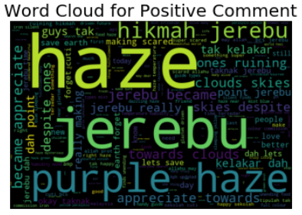
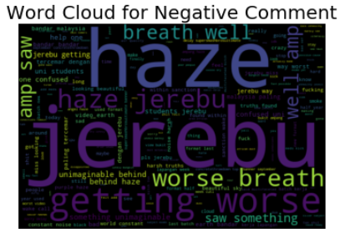
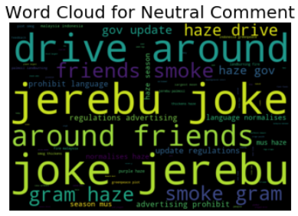
Data collection and description
WQD7005 - Data Mining
Milestone Project | Pollutant Standard Index and Tourism Share Prices in Singapore
Master of Data Science | University of Malaya

Slide 13
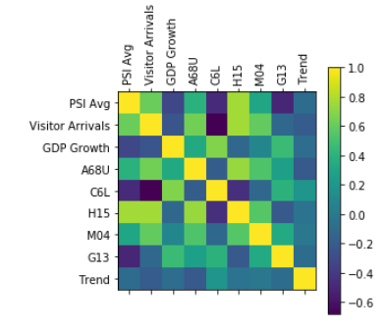
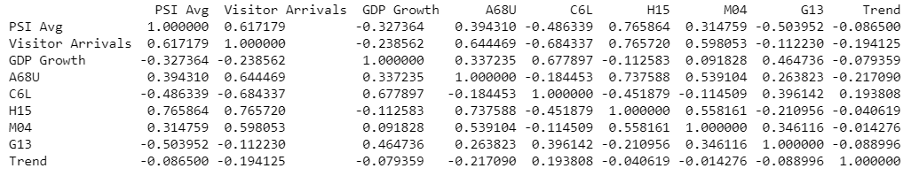
Results
Correlation analysis
WQD7005 - Data Mining
Milestone Project | Pollutant Standard Index and Tourism Share Prices in Singapore
Master of Data Science | University of Malaya

Slide 14
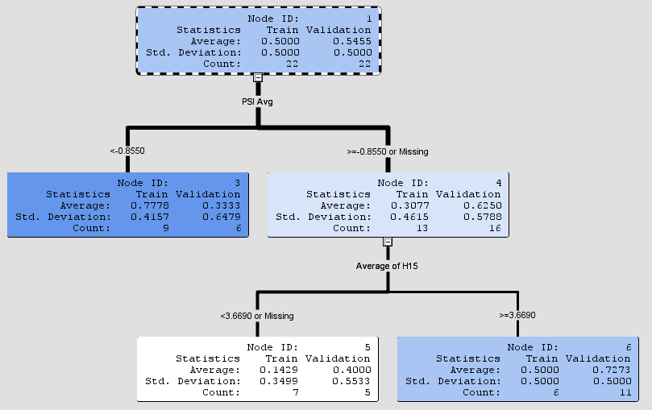
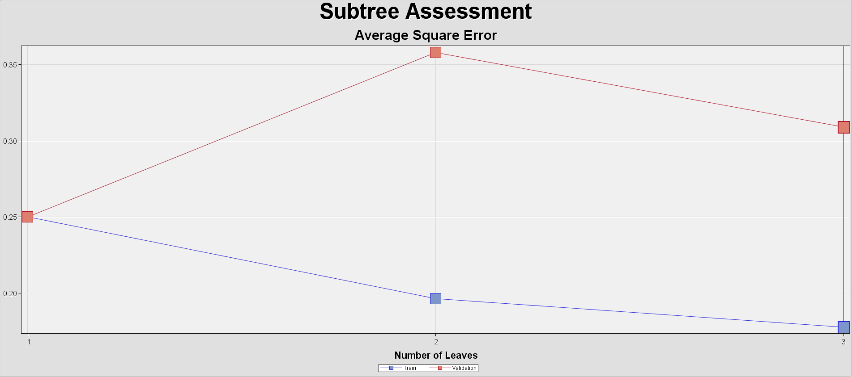
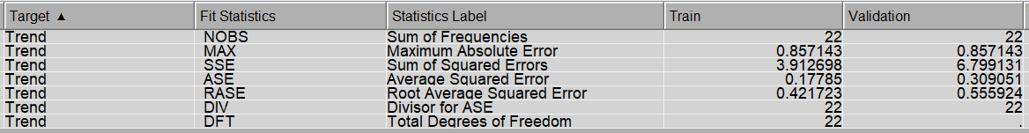
Results
Interactive Decision Tree
WQD7005 - Data Mining
Milestone Project | Pollutant Standard Index and Tourism Share Prices in Singapore
Master of Data Science | University of Malaya

Slide 15
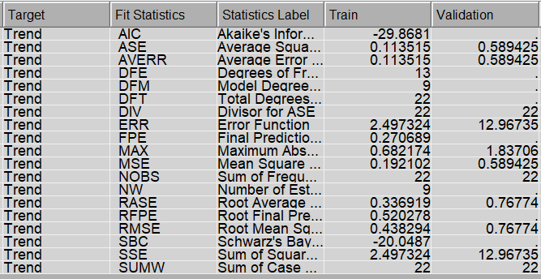
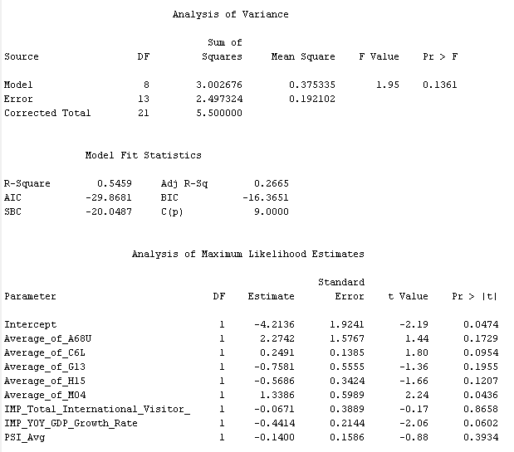
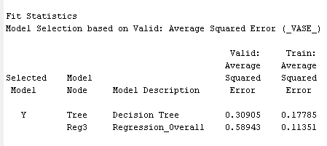
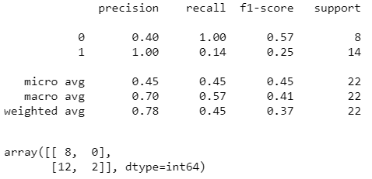
Results
Logit Regression
WQD7005 - Data Mining
Milestone Project | Pollutant Standard Index and Tourism Share Prices in Singapore
Master of Data Science | University of Malaya

Slide 16
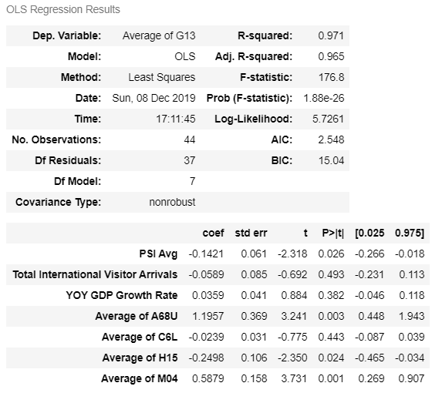
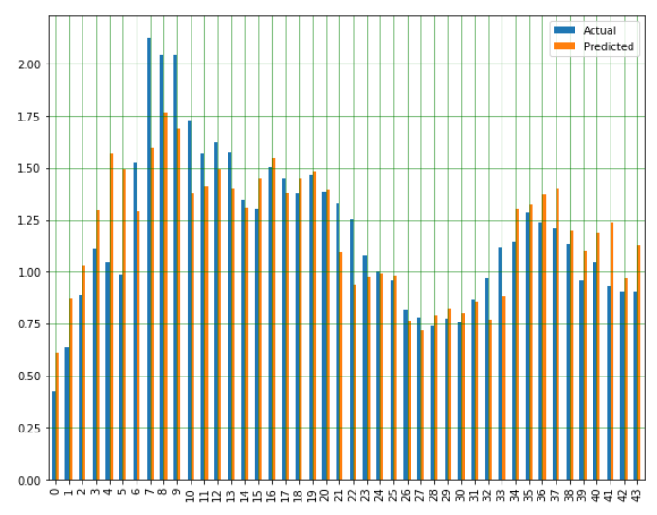

Results
Linear Regression (OLS)
WQD7005 - Data Mining
Milestone Project | Pollutant Standard Index and Tourism Share Prices in Singapore
Master of Data Science | University of Malaya

Slide 17
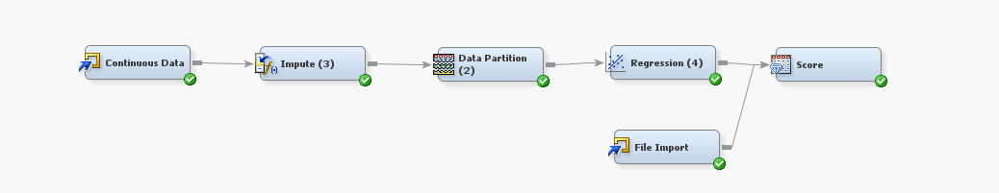
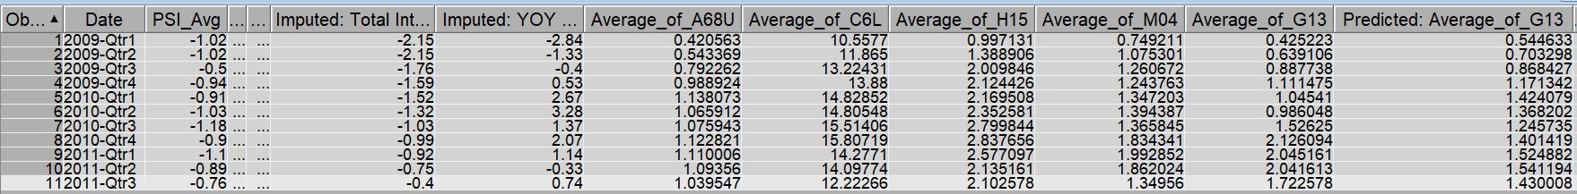
Results
Linear Regression
WQD7005 - Data Mining
Milestone Project | Pollutant Standard Index and Tourism Share Prices in Singapore
Master of Data Science | University of Malaya

Slide 18
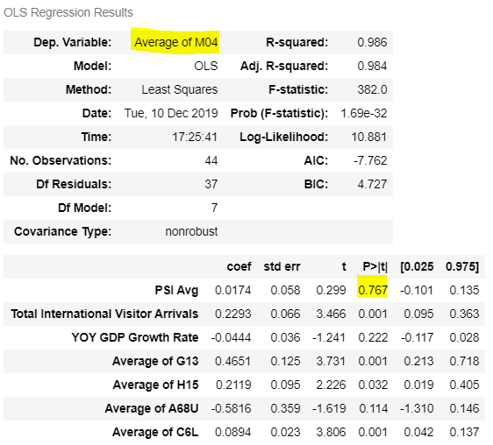
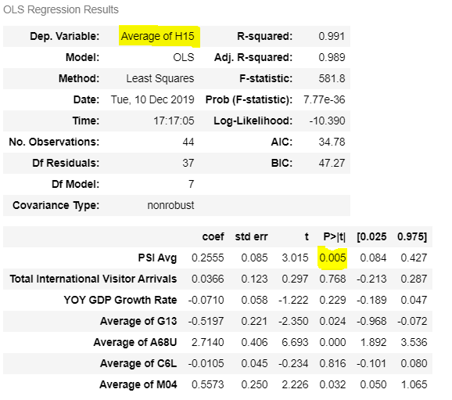
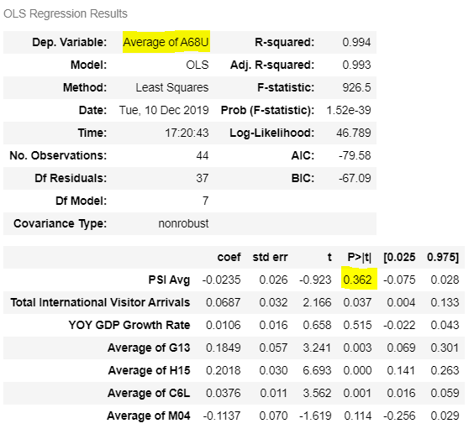
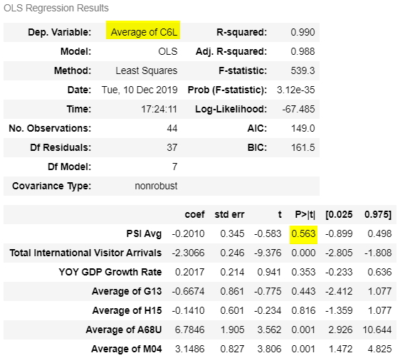
Results
Linear Regression (OLS) – Other stocks
WQD7005 - Data Mining
Milestone Project | Pollutant Standard Index and Tourism Share Prices in Singapore
Master of Data Science | University of Malaya

Slide 19
Conclusions
PSI did affect the share price of G13 and was negatively correlated to it.
G13 share price was affected by other stock prices in the same industry.
Factors such as number of tourist arrival and GDP growth rate has minimum effect on the stock price of G13.
PSI also affected other stocks such as stock H15.
Public sentiment towards haze mostly was neutral and positive.
WQD7005 - Data Mining
Milestone Project | Pollutant Standard Index and Tourism Share Prices in Singapore
Master of Data Science | University of Malaya

Slide 20
REFERENCES
Gross Domestic Product In Chained (2015) Dollars, Year on Year Growth Rate, Quarterly. (n.d.). Retrieved from https://data.gov.sg/dataset/gross-domestic-product-in-chained-2015-dollars-year-on-year-growth-rate-quarterly.
HazeShield: Swiss Re. (2017, July 11). Retrieved from https://corporatesolutions.swissre.com/innovative-risk-solutions/non-physical-damage-business-interruption/hazeshield.html.
Pollutant Standards Index. (2019, September 25). Retrieved from https://en.wikipedia.org/wiki/Pollutant_Standards_Index.
Pollutant Standards Index (PSI). (2016, April 8). Retrieved from https://data.gov.sg/dataset/psi.
Singapore Department Of Statistics: SingStat Table Builder - Variables/Time Period Selection. (n.d.). Retrieved from https://www.tablebuilder.singstat.gov.sg/publicfacing/createDataTable.action?refId=1991.
Tourism-Related Stocks Ride Growth in Visitor Arrivals: SGX My Gateway. (2019, January 31). Retrieved from https://sginvestors.io/sgx-mygateway/2019/01/tourism-related-stocks-ride-growth-in-visitor-arrivals.
Twitter. It's what's happening. (n.d.). Retrieved from https://twitter.com/.
Yahoo Finance – stock market live, quotes, business & finance news. (n.d.). Retrieved from https://sg.finance.yahoo.com/.
WQD7005 - Data Mining
Milestone Project | Pollutant Standard Index and Tourism Share Prices in Singapore
Master of Data Science | University of Malaya

Slide 21

THANK YOU.
WQD7005 - Data Mining
Milestone Project | Pollutant Standard Index and Tourism Share Prices in Singapore
Master of Data Science | University of Malaya

